Slide 1
VIT University, Bhopal
SASL
Course Name: PHY 1001
L-T-P 4

Slide 2
Marks break up
Total marks 100
Cat 1 15%
Cat 2 15%
Fat 30%
Internal assessment 25%
Attendance 5%
Assignment 10%

Slide 3
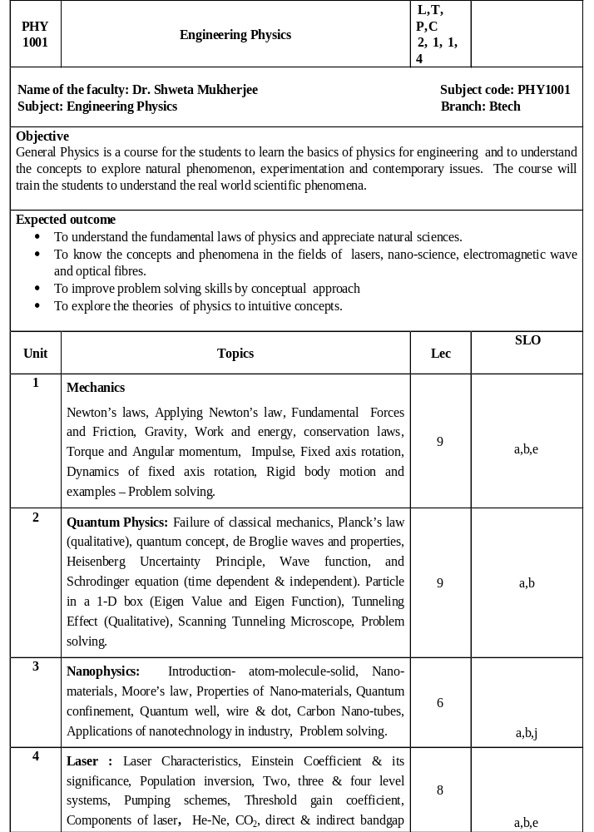

Slide 4
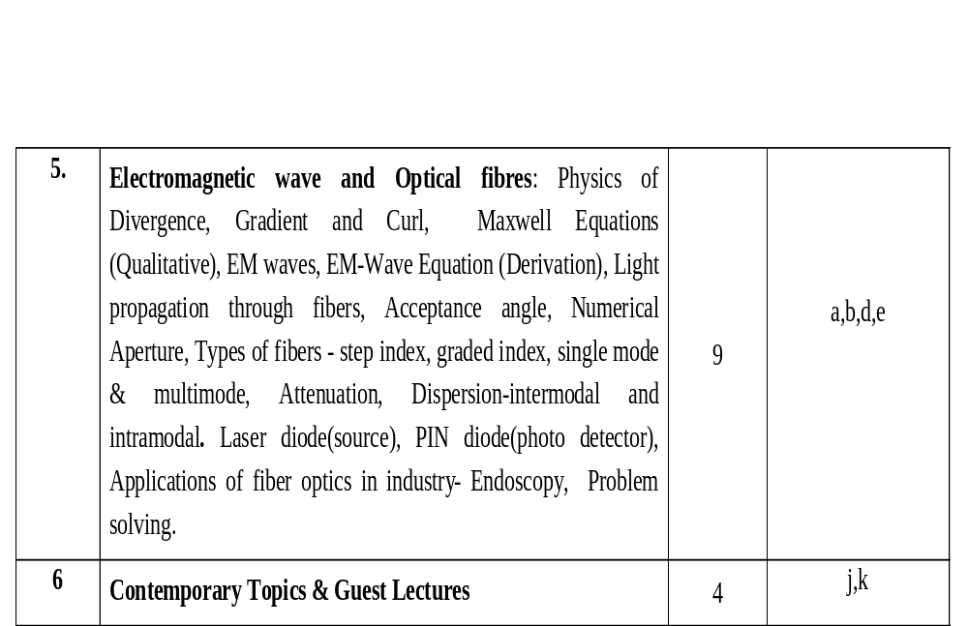

Slide 5
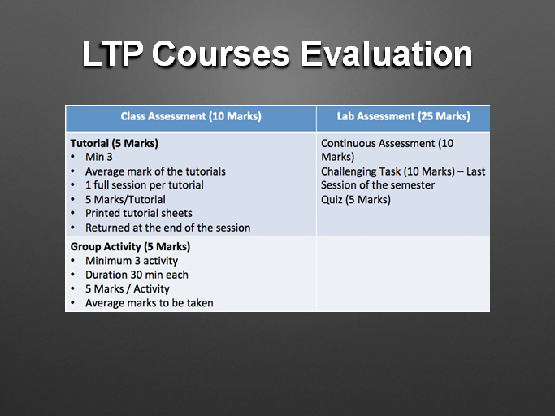

Slide 6
Books
Mechanics, Keith R. Symon
Fundamental Physics, Halliday – Resnick,
Concepts of Modern Physics, Arthur Beiser
Laser Fundamentals, William T. Silfvast
Introduction to Electrodynamics, D. J. Griffith

Slide 7
https://youtu.be/64RvhCyGFlM

Slide 8
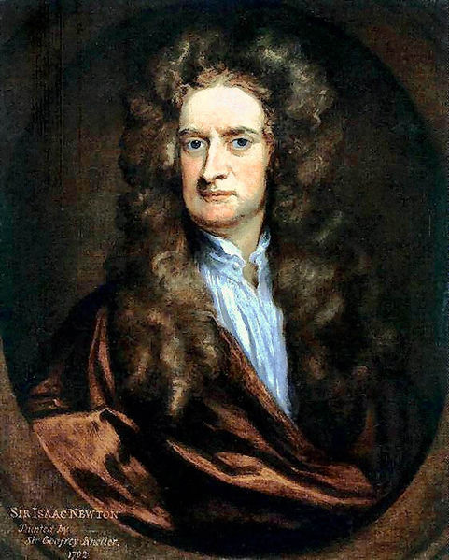


Newton’s Laws
“If I have ever made any valuable discoveries, it has been owing more to patient attention, than to any other talent.” -Sir Isaac Newton
State of Rest
State of Motion

Slide 9
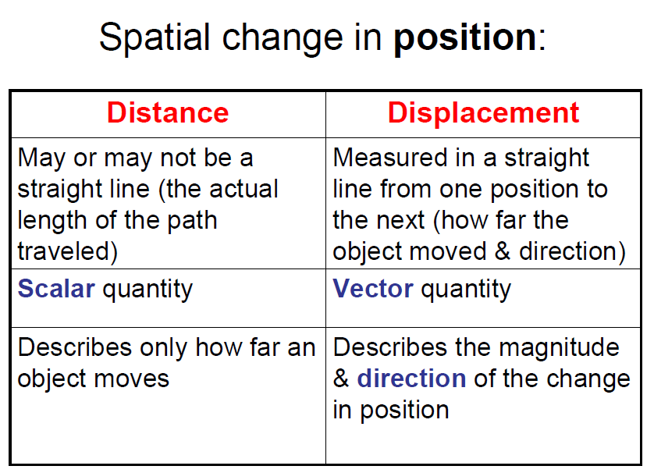

Slide 10
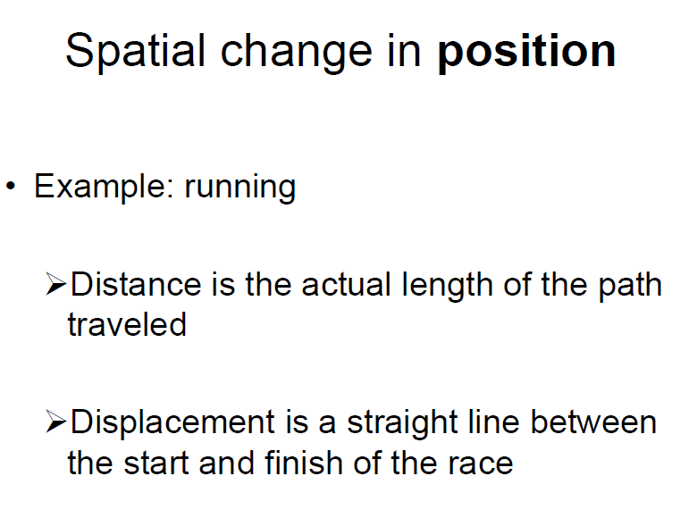

Slide 11
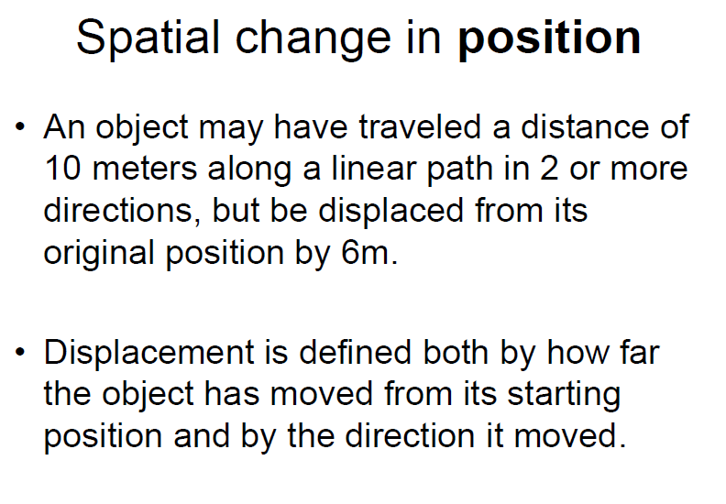

Slide 12
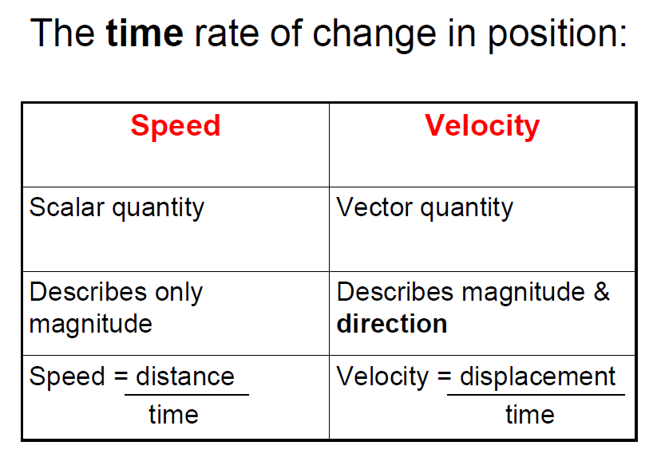

Slide 13
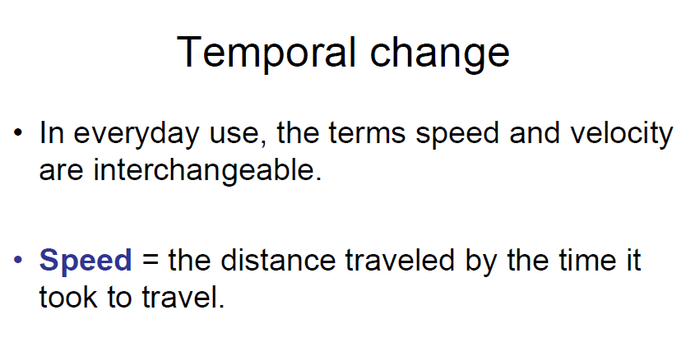

Slide 14
Sir Isaac Newton (1643-1727) an English scientist and mathematician famous for his discovery of the law of gravity also discovered the three laws of motion. He published them in his book Philosophiae Naturalis Principia Mathematica (mathematic principles of natural philosophy) in 1687. Today these laws are known as Newton’s Laws of Motion and describe the motion of all objects on the scale we experience in our everyday lives.

Slide 15
Newton’s Laws of Motion
1. An object in motion tends to stay in motion and an object at rest tends to stay at rest unless acted upon by an unbalanced force.
2. Force equals mass times acceleration
(F = ma).
3. For every action there is an equal and opposite reaction.

Slide 16
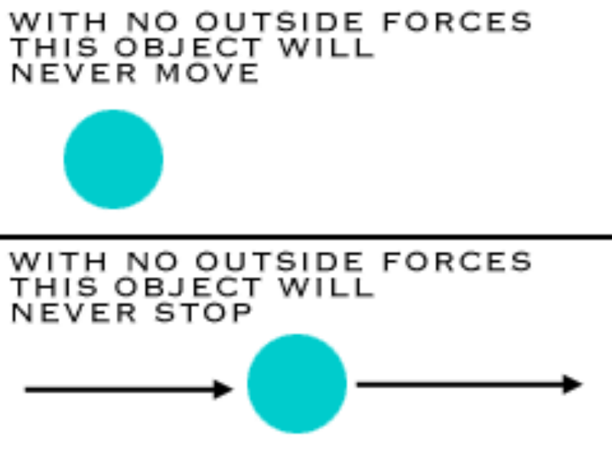
Newton’s Law #1
What does this mean?
If nothing is happening to you and nothing does happen you will never go anywhere.
If you're going in a specific direction, unless something happens to you, you will always go in that direction.
Forever.
Things don’t move unless a force is applied to them.

Slide 18
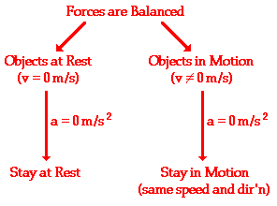

Slide 19
If the net force on a body is zero, its velocity will not change
An unbalanced force will always impact the object’s speed
The reason why initially moving objects tends to come to rest
in our everyday life is because they are being acted on by unbalanced forces
An unbalanced force on an object will always change the object’s velocity.

Slide 20
An object at rest tends to stay at rest and an object in motion tends to stay in motion unless acted upon by an unbalanced force.

Slide 21
What does this mean?
Basically, an object will “keep doing what it was doing” unless acted on by an unbalanced force.
If the object was sitting still, it will remain stationary. If it was moving at a constant velocity, it will keep moving.
It takes force to change the motion of an object.

Slide 22
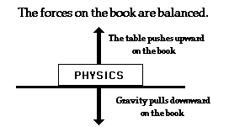
What is meant by unbalanced force?
If the forces on an object are equal and opposite, they are said to be balanced, and the object experiences no change in motion. If they are not equal and opposite, then the forces are unbalanced and the motion of the object changes.

Slide 23


Some Examples from Real Life
A soccer ball is sitting at rest. It takes an unbalanced force of a kick to change its motion.
Two teams are playing tug of war. They are both exerting equal force on the rope in opposite directions. This balanced force results in no change of motion.

Slide 24
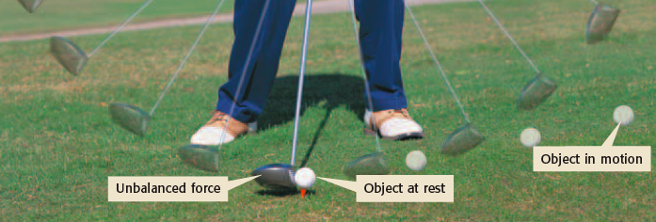
A golf ball on a tee will remain on the tee until the club, the unbalanced force, makes contact with it.

Slide 25
Newton’s First Law is also called the Law of Inertia
Inertia: the tendency of an object to resist changes in its state of motion
The First Law states that all objects have inertia. The more mass an object has, the more inertia it has (and the harder it is to change its motion).

Slide 26
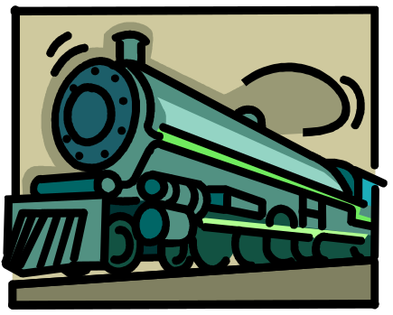

More Examples from Real Life
A powerful locomotive begins to pull a long line of boxcars that were sitting at rest. Since the boxcars are so massive, they have a great deal of inertia and it takes a large force to change their motion. Once they are moving, it takes a large force to stop them.
On your way to school, a bug flies into your windshield. Since the bug is so small, it has very little inertia and exerts a very small force on your car (so small that you don’t even feel it).

Slide 27


If objects in motion tend to stay in motion, why don’t moving objects keep moving forever?
Things don’t keep moving forever because there’s almost always an unbalanced force acting upon it.
A book sliding across a table slows down and stops because of the force of friction.
If you throw a ball upwards it will eventually slow down and fall because of the force of gravity.

Slide 28

In outer space, away from gravity and any sources of friction, a rocket ship launched with a certain speed and direction would keep going in that same direction and at that same speed forever.

Slide 29
Newton’s Second Law
Force equals mass times acceleration.
F = ma
Acceleration: a measurement of how quickly an object is changing speed.

Slide 30
What does F = ma mean?
Force is directly proportional to mass and acceleration. Imagine a ball of a certain mass moving at a certain acceleration. This ball has a certain force.
Now imagine we make the ball twice as big (double the mass) but keep the acceleration constant. F = ma says that this new ball has twice the force of the old ball.
Now imagine the original ball moving at twice the original acceleration. F = ma says that the ball will again have twice the force of the ball at the original acceleration.

Slide 31
More about F = ma
If you double the mass, you double the force. If you double the acceleration, you double the force.
What if you double the mass and the acceleration?
(2m)(2a) = 4F
Doubling the mass and the acceleration quadruples the force.
So . . . what if you decrease the mass by half? How much force would the object have now?

Slide 32
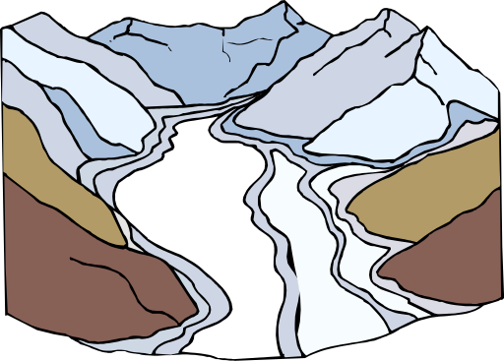

What does F = ma say?
F = ma basically means that the force of an object comes from its mass and its acceleration.
Something very massive (high mass) that’s changing speed very slowly (low acceleration), like a glacier, can still have great force.
Something very small (low mass) that’s changing speed very quickly (high acceleration), like a bullet, can still have a great force. Something very small changing speed very slowly will have a very weak force.

Slide 33
Newton’s Third Law
For every action there is an equal and opposite reaction.

Slide 34

What does this mean?
For every force acting on an object, there is an equal force acting in the opposite direction. Right now, gravity is pulling you down in your seat, but Newton’s Third Law says your seat is pushing up against you with equal force. This is why you are not moving. There is a balanced force acting on you– gravity pulling down, your seat pushing up.

Slide 35

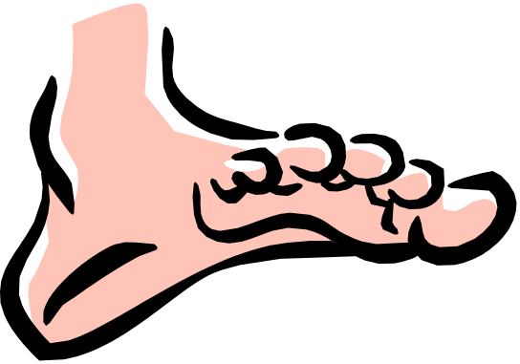
Think about it . . .
What happens if you are standing on a skateboard or a slippery floor and push against a wall? You slide in the opposite direction (away from the wall), because you pushed on the wall but the wall pushed back on you with equal and opposite force.
Why does it hurt so much when you stub your toe? When your toe exerts a force on a rock, the rock exerts an equal force back on your toe. The harder you hit your toe against it, the more force the rock exerts back on your toe (and the more your toe hurts).

Slide 36
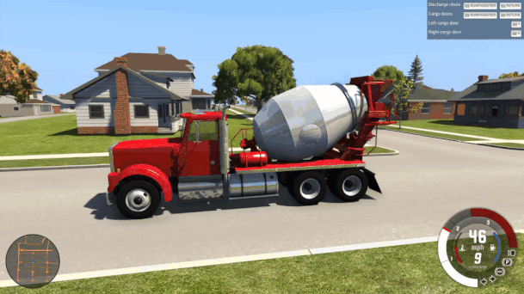
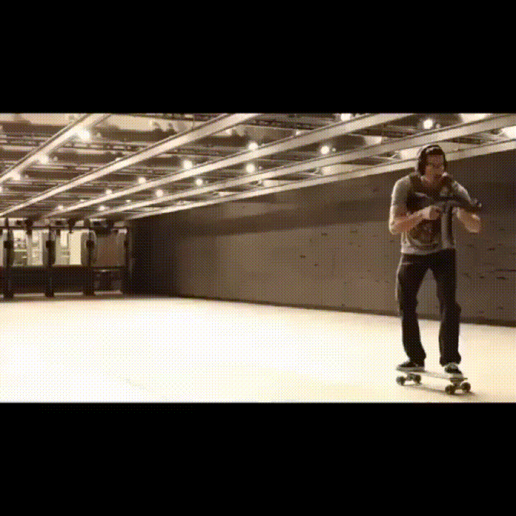

Slide 37
Review
Newton’s First Law:
Objects in motion tend to stay in motion and objects at rest tend to stay at rest unless acted upon by an unbalanced force.
Newton’s Second Law:
Force equals mass times acceleration (F = ma).
Newton’s Third Law:
For every action there is an equal and opposite reaction.

Slide 38
Vocabulary
Inertia:
the tendency of an object to resist changes in its state of motion
Acceleration:
•a change in velocity
•a measurement of how quickly an object is changing speed, direction or both
Velocity:
The rate of change of a position along a straight line with respect to time
Force:
strength or energy

Slide 39
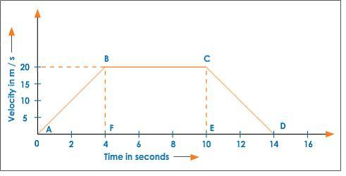
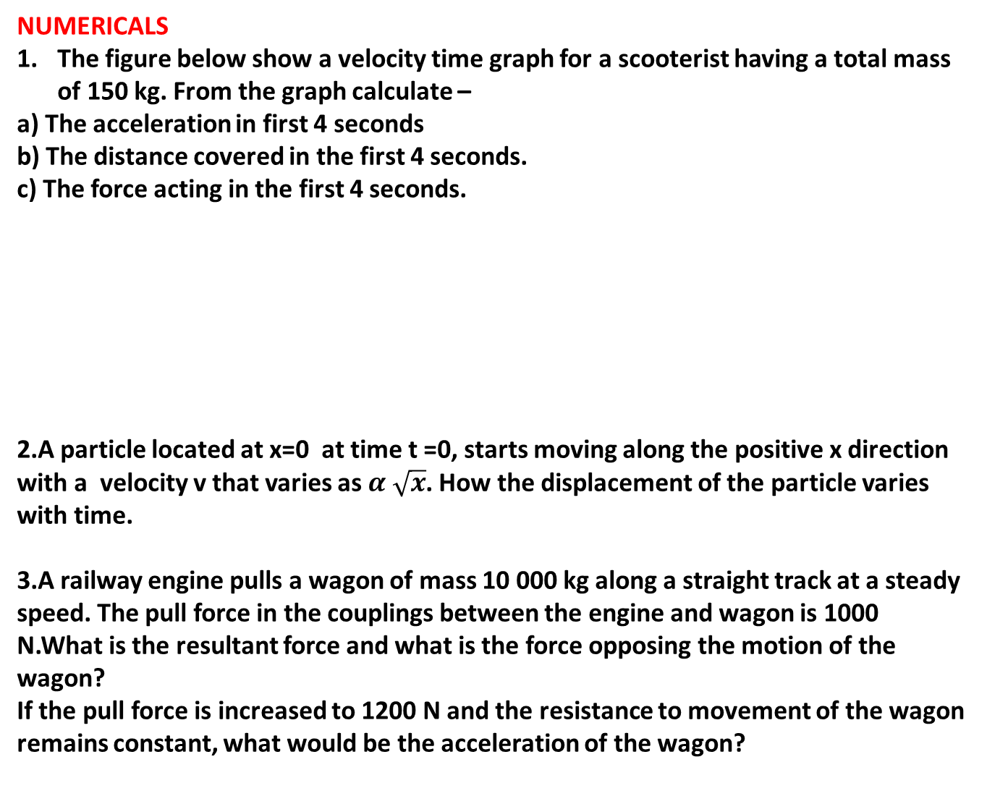
NUMERICALS
The figure below show a velocity time graph for a scooterist having a total mass of 150 kg. From the graph calculate –
a) The acceleration in first 4 seconds
b) The distance covered in the first 4 seconds.
c) The force acting in the first 4 seconds.
2.A particle located at x=0 at time t =0, starts moving along the positive x direction with a velocity v that varies as $α \sqrt{x}$. How the displacement of the particle varies with time.
3.A railway engine pulls a wagon of mass 10 000 kg along a straight track at a steady speed. The pull force in the couplings between the engine and wagon is 1000 N.What is the resultant force and what is the force opposing the motion of the wagon?
If the pull force is increased to 1200 N and the resistance to movement of the wagon remains constant, what would be the acceleration of the wagon?

Slide 40
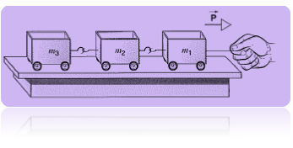
3.A child’s toy consists of three cars that are pulled in tandem on small frictionless rollers as shown in below figure. The cars have masses m₁ = 3.1 kg, m₂ = 2.4 kg, and m₃ = 1.2 kg. If they are pulled to the right with a horizontal force P = 6.5 N, find (a) the acceleration of the system, (b) the force exerted by the second car on the third car, and (c) the force exerted by the first car on the second car.

Slide 41
Review
Newton’s First Law:
Objects in motion tend to stay in motion and objects at rest tend to stay at rest unless acted upon by an unbalanced force.
Newton’s Second Law:
Force equals mass times acceleration (F = ma).
Newton’s Third Law:
For every action there is an equal and opposite reaction.

Slide 42
Vocabulary
Inertia:
the tendency of an object to resist changes in its state of motion
Acceleration:
•a change in velocity
•a measurement of how quickly an object is changing speed, direction or both
Velocity:
The rate of change of a position along a straight line with respect to time
Force:
strength or energy

Slide 43
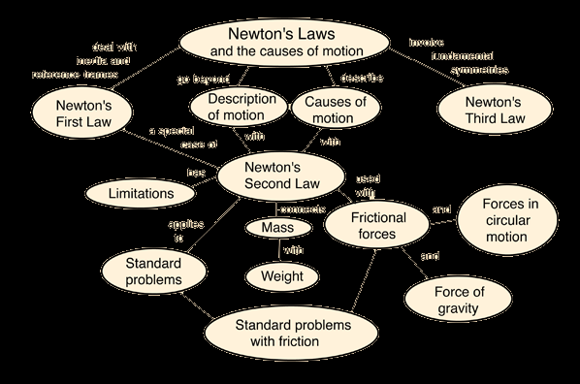

Slide 44
Experiment
Verification of Newton’s Second Law

